Slide 1
Macro Processors
Chapter 4
System Software
An introduction to systems programming
Leland L. Beck

Slide 2
Introduction
Concept
  A macro instruction is a notational convenience for the programmer
  It allows the programmer to write shorthand version of a program (module programming)
  The macro processor replaces each macro invocation with the corresponding sequence of statements (expanding)

Slide 3
Macro Processor
Recognize macro definitions
Save the macro definition
Recognize macro calls
Expand macro calls
Source Code
(with macro)
Macro Processor
Expanded Code
Compiler or Assembler
obj

Slide 4
Macro Definition
copy code
parameter substitution
conditional macro expansion
macro instruction defining macros

Slide 5
Copy code -- Example
Source
STRG MACRO
STA DATA1
STB DATA2
STX DATA3
MEND
.
STRG
.
STRG
.
.
Expanded source
.
.
.
STA DATA1
STB DATA2
STX DATA3
.
STA DATA1
STB DATA2
STX DATA3
.
{
{

Slide 6
Macro vs. Subroutine
Macro
  the statement of expansion are generated each time the macro are invoked
Subroutine
  the statement in a subroutine appears only once

Slide 7
Parameter Substitution -- Example
Source
STRG MACRO &a1, &a2, &a3
STA &a1
STB &a2
STX &a3
MEND
.
STRG DATA1, DATA2, DATA3
.
STRG DATA4, DATA5, DATA6
.
.
Expanded souce
.
.
.
STA DATA1
STB DATA2
STX DATA3
.
STA DATA4
STB DATA5
STX DATA6
.
{
{

Slide 8
Parameter Substitution
Dummy arguments
  Positional argument
STRG DATA1, DATA2, DATA3
GENER ,,DIRECT,,,,,,3
  Keyword argument
STRG &a3=DATA1, &a2=DATA2, &a1=DATA3 GENER TYPE=DIRECT, CHANNEL=3
Example: Fig. 4.1, Fig. 4.2
  Labels are avoided in macro definition

Slide 9
One-Pass Macro Processor
Prerequisite
  every macro must be defined before it is called
Sub-procedures
  macro definition: DEFINE
  macro invocation: EXPAND
NAMTAB
MACRO
DEFINE
DEFTAB
PROCESSLINE
ARGTAB
CALL
EXPAND

Slide 10
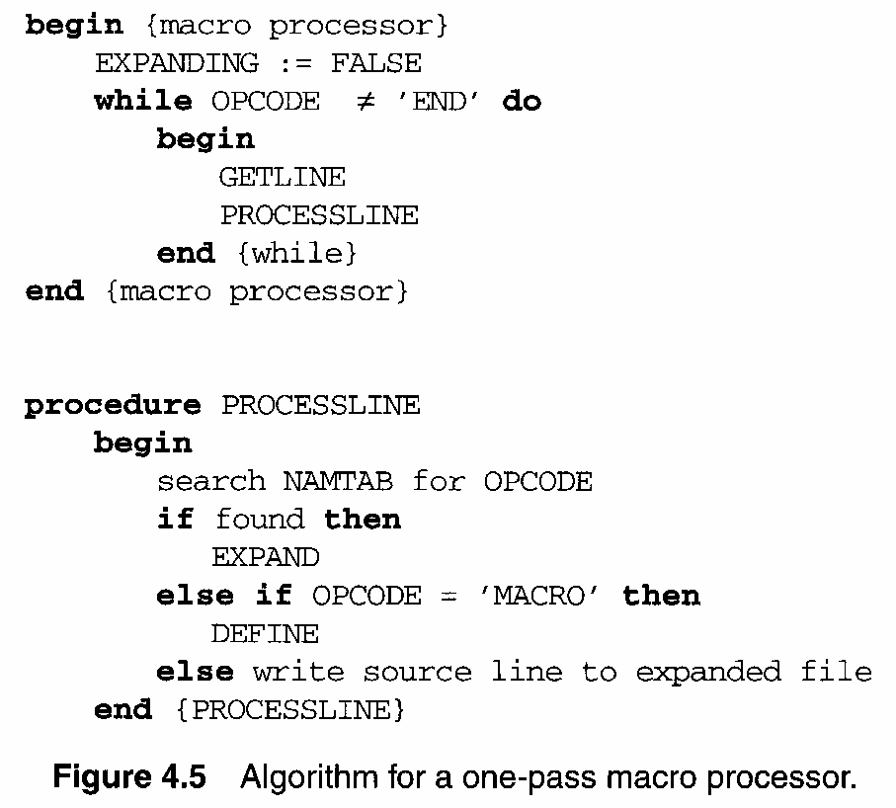

Slide 11
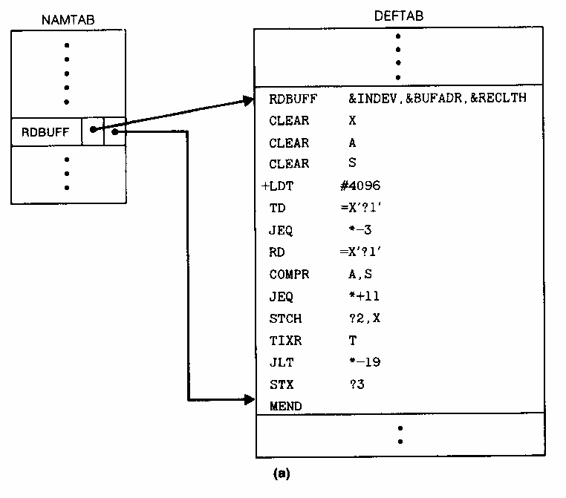
Data Structures -- Global Variables
DEFTAB
NAMTAB
ARGTAB
EXPANDING

Slide 12
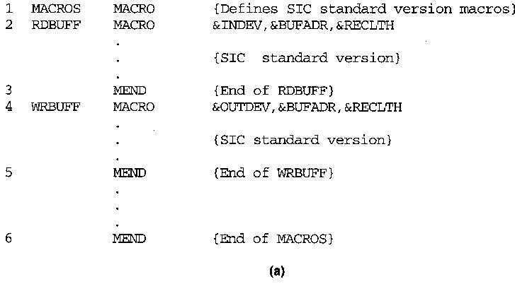
Nested Macros Definition
Macro definition within macros
  process macro definition during expansion time
Example 4.3

Slide 13
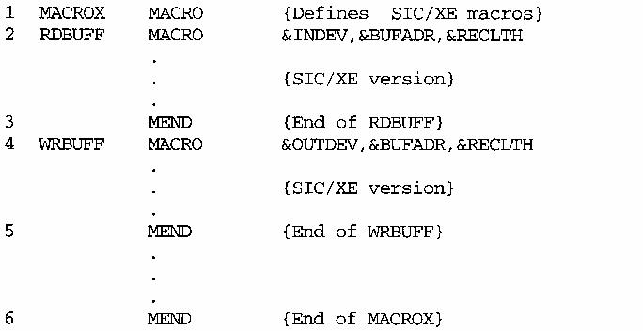
Figure 4.3 (b)

Slide 14
One-Pass Macro Processor That Allows Nested Macro Definition
Sub-procedures
  macro definition: DEFINE
  macro invocation: EXPAND
EXPAND may invoke DEFINE when encounter macro definition
NAMTAB
DEFINE
MACRO
DEFTAB
PROCESSLINE
CALL
EXPAND
ARGTAB
Expanding
MACRO Definition

Slide 15
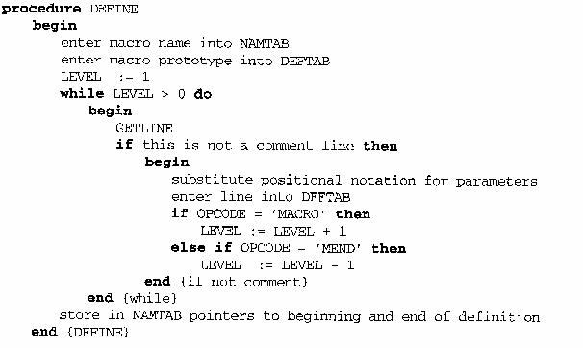

Slide 16
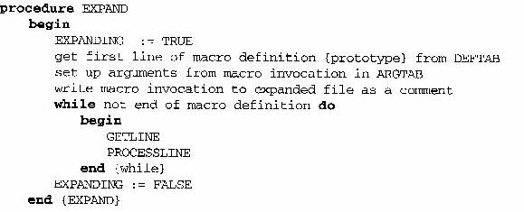
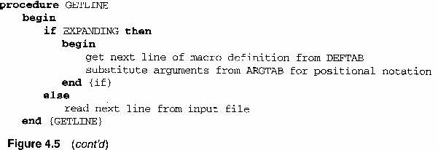

Slide 17
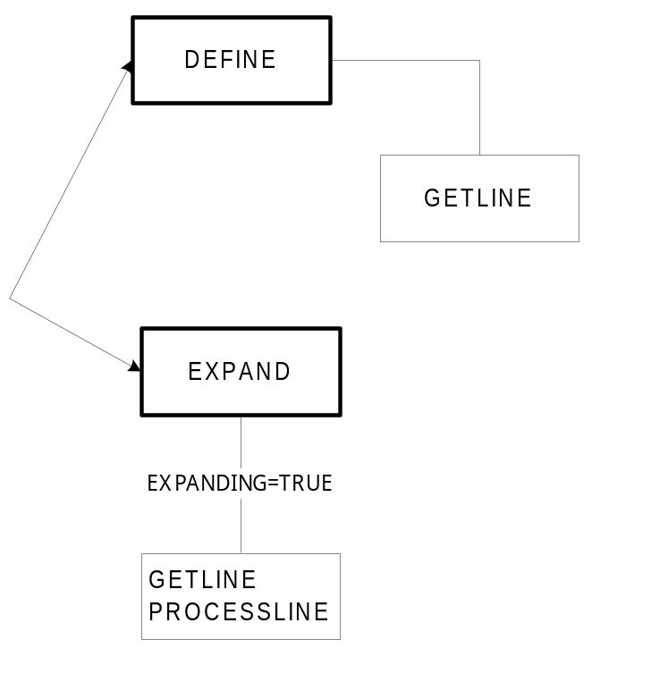
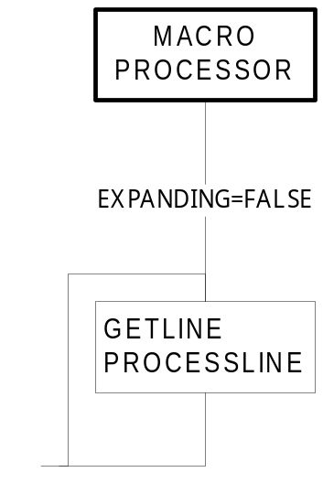

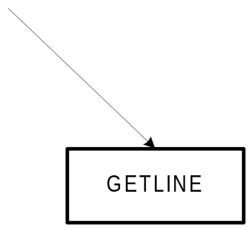
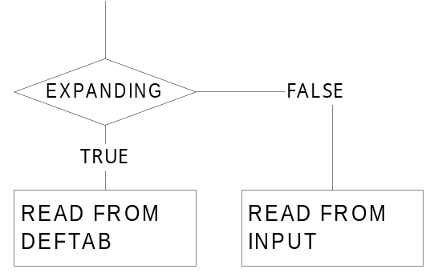
1-Pass Macro Processor

Slide 18
Comparison of Macro Processors Design
Single pass
  every macro must be defined before it is called
  one-pass processor can alternate between macro definition and macro expansion
  nested macro definitions may be allowed but nested calls are not
Two pass algorithm
  Pass1: Recognize macro definitions
  Pass2: Recognize macro calls
  nested macro definitions are not allowed

Slide 19
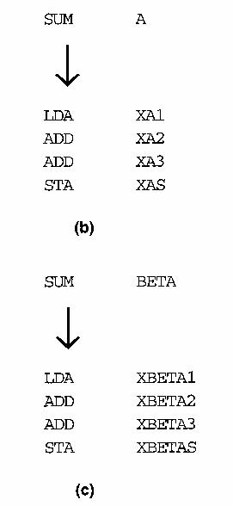
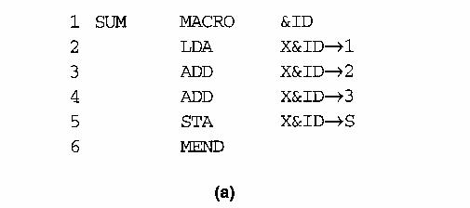
Concatenation of Macro Parameters
Pre-concatenation
  LDA X&ID1
Post-concatenation
  LDA X&ID→1
Example: Figure 4.6

Slide 20
Generation of Unique Labels
Example
  JEQ *-3
  inconvenient, error-prone, difficult to read
Example Figure 4.7
    $LOOP TD =X’&INDEV’
  1st call:
    $AALOOP TD =X’F1’
  2nd call:
    $ABLOOP TD =X’F1’

Slide 21
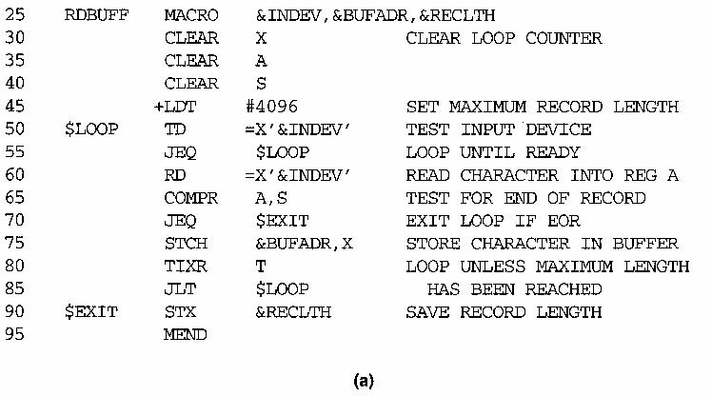

Slide 22
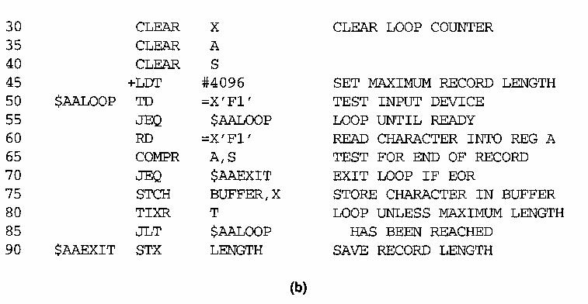
RDBUFF F1, BUFFER, LENGTH

Slide 23
Conditional Macro Expansion
Macro-time conditional statements
  Example: Figure 4.8
  IF-ELSE-ENDIF
Macro-time variables
  any symbol that begins with the character & and that is not a macro parameter
  macro-time variables are initialized to 0
  macro-time variables can be changed with their values using SET
    &EORCK SET 1

Slide 24
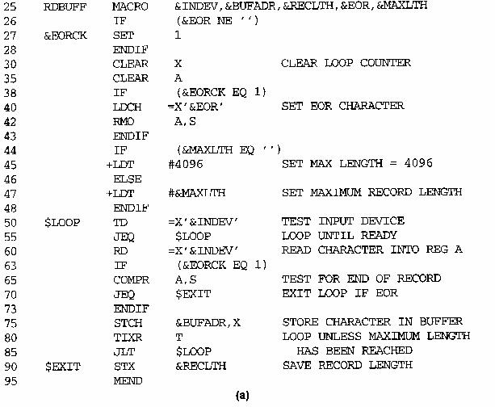

Slide 25
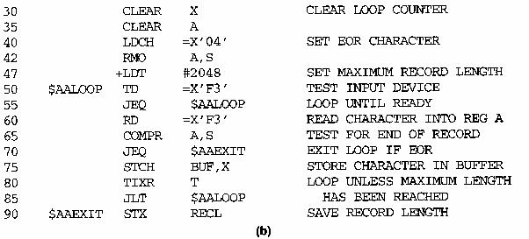
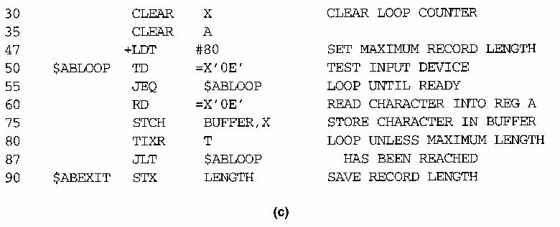
RDBUFF F3, BUF, RECL, 04, 2048
RDBUFF 0E, BUFFER, LENGTH, , 80

Slide 26
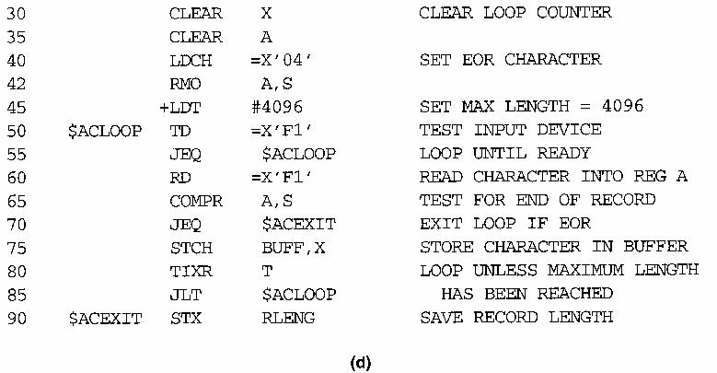
RDBUFF F1, BUFF, RLENG, 04

Slide 27
Conditional Macro Expansion (Cont.)
Macro-time looping statement
  Example: Figure 4.9
  WHILE-ENDW
Macro processor function
  %NITEMS: THE NUMBER OF MEMBERS IN AN ARGUMENT LIST

Slide 28
Nested Macro Invocations
Macro invocations within macros
  process macro invocation during expansion time
Recursive macro expansion
  Example: Figure 4.11
  Problems:
    ARGTAB
    EXPANDING
  Solution
    Recursive call
    While loop with stack

Slide 29
ARGTAB
DEFTAB
MACRO Definition
DEFINE
NAMTAB
GETLINE
PROCESSLINE
Macro Invocation
EXPAND
ARGTAB

Slide 30
1-Pass Macro Processor

Slide 31
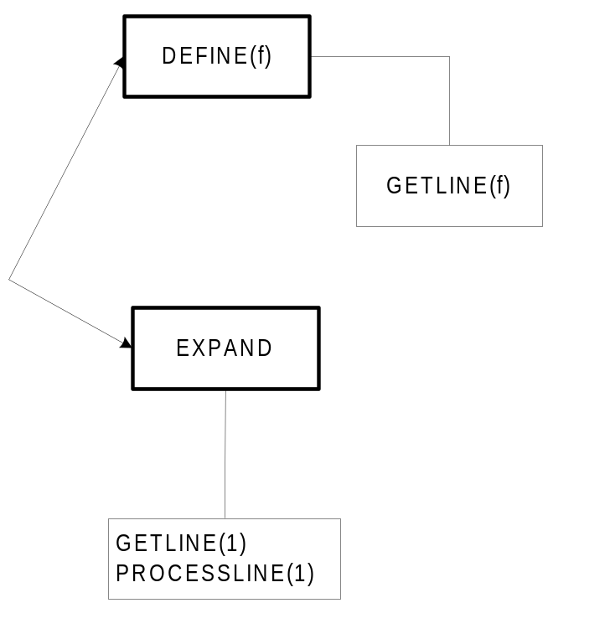
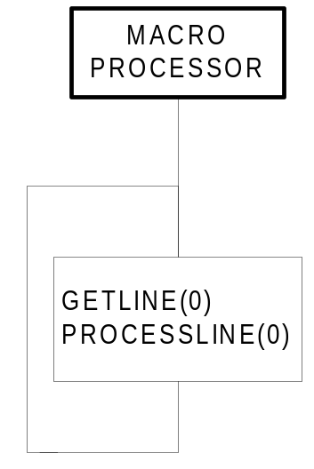
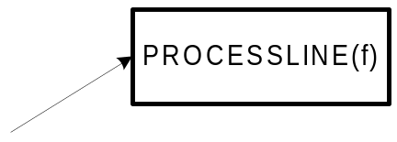
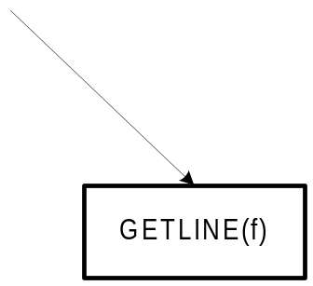
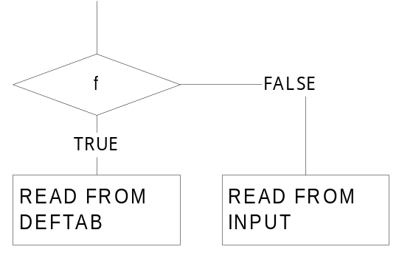
Allowing Nested Macro Invocation

Slide 32
Macro-Assembler
Advantage
  reduce 1 pass
  share same data structure
Disadvantage
  more complex

Slide 33
Pass 1
READ
Search
(Pseudo-Op Table)
Pass 2
R
Type?
Search NAMTAB
(Macro Name Table)
MACRO
Define
Process
pseudo-ops
Search
(Machine Op Table)
R
R
MACRO
Expand
Process machine instruction
R
R

Slide 34
General Purpose Macro Processor
ELENA
  Software: Practice and Experience, Vol. 14, pp. 519-531, Jun. 1984
Macro definition
  header:
    a sequence of keywords and parameter markers (%)
    at least one of the first two tokens in a macro header must be a keyword, not a parameter marker
  body:
    the character & identifies a local label
    macro time instruction (.SET, .IF .JUMP, .E)
    macro time variables or labels (.)

Slide 35
ELENA (cont.)
Macro invocation
  There is no single token that constitutes the macro “name”
  Constructing an index of all macro headers according to the keywords in the first two tokens of the header
  Example
    DEFINITION:
      ADD %1 TO %2
      ADD %1 TO THE FIRST ELEMENT OF %2
    INVOCATION:
      DISPLAY TABLE
DISPLAY %1
%1 TABLE

